Slide 1
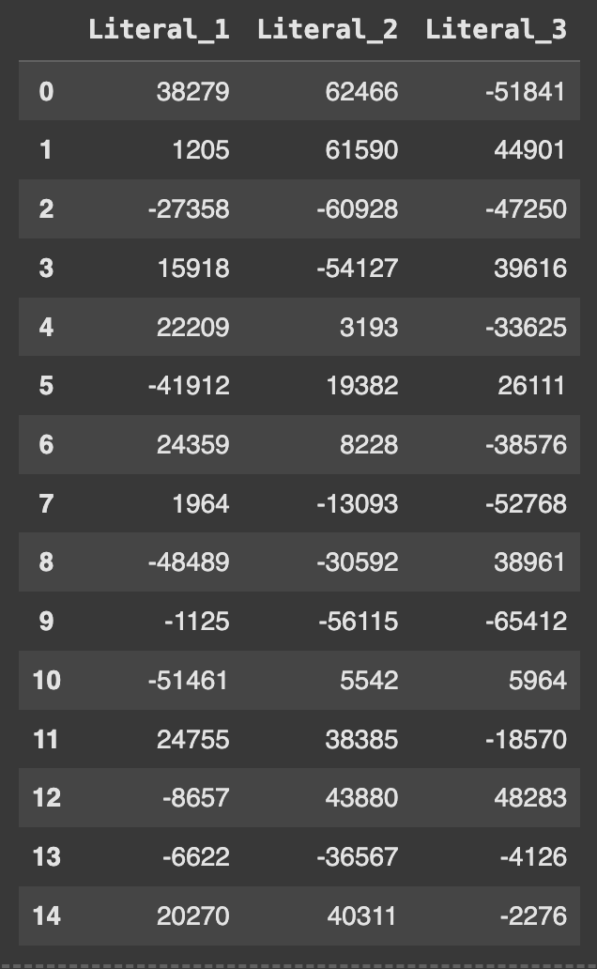

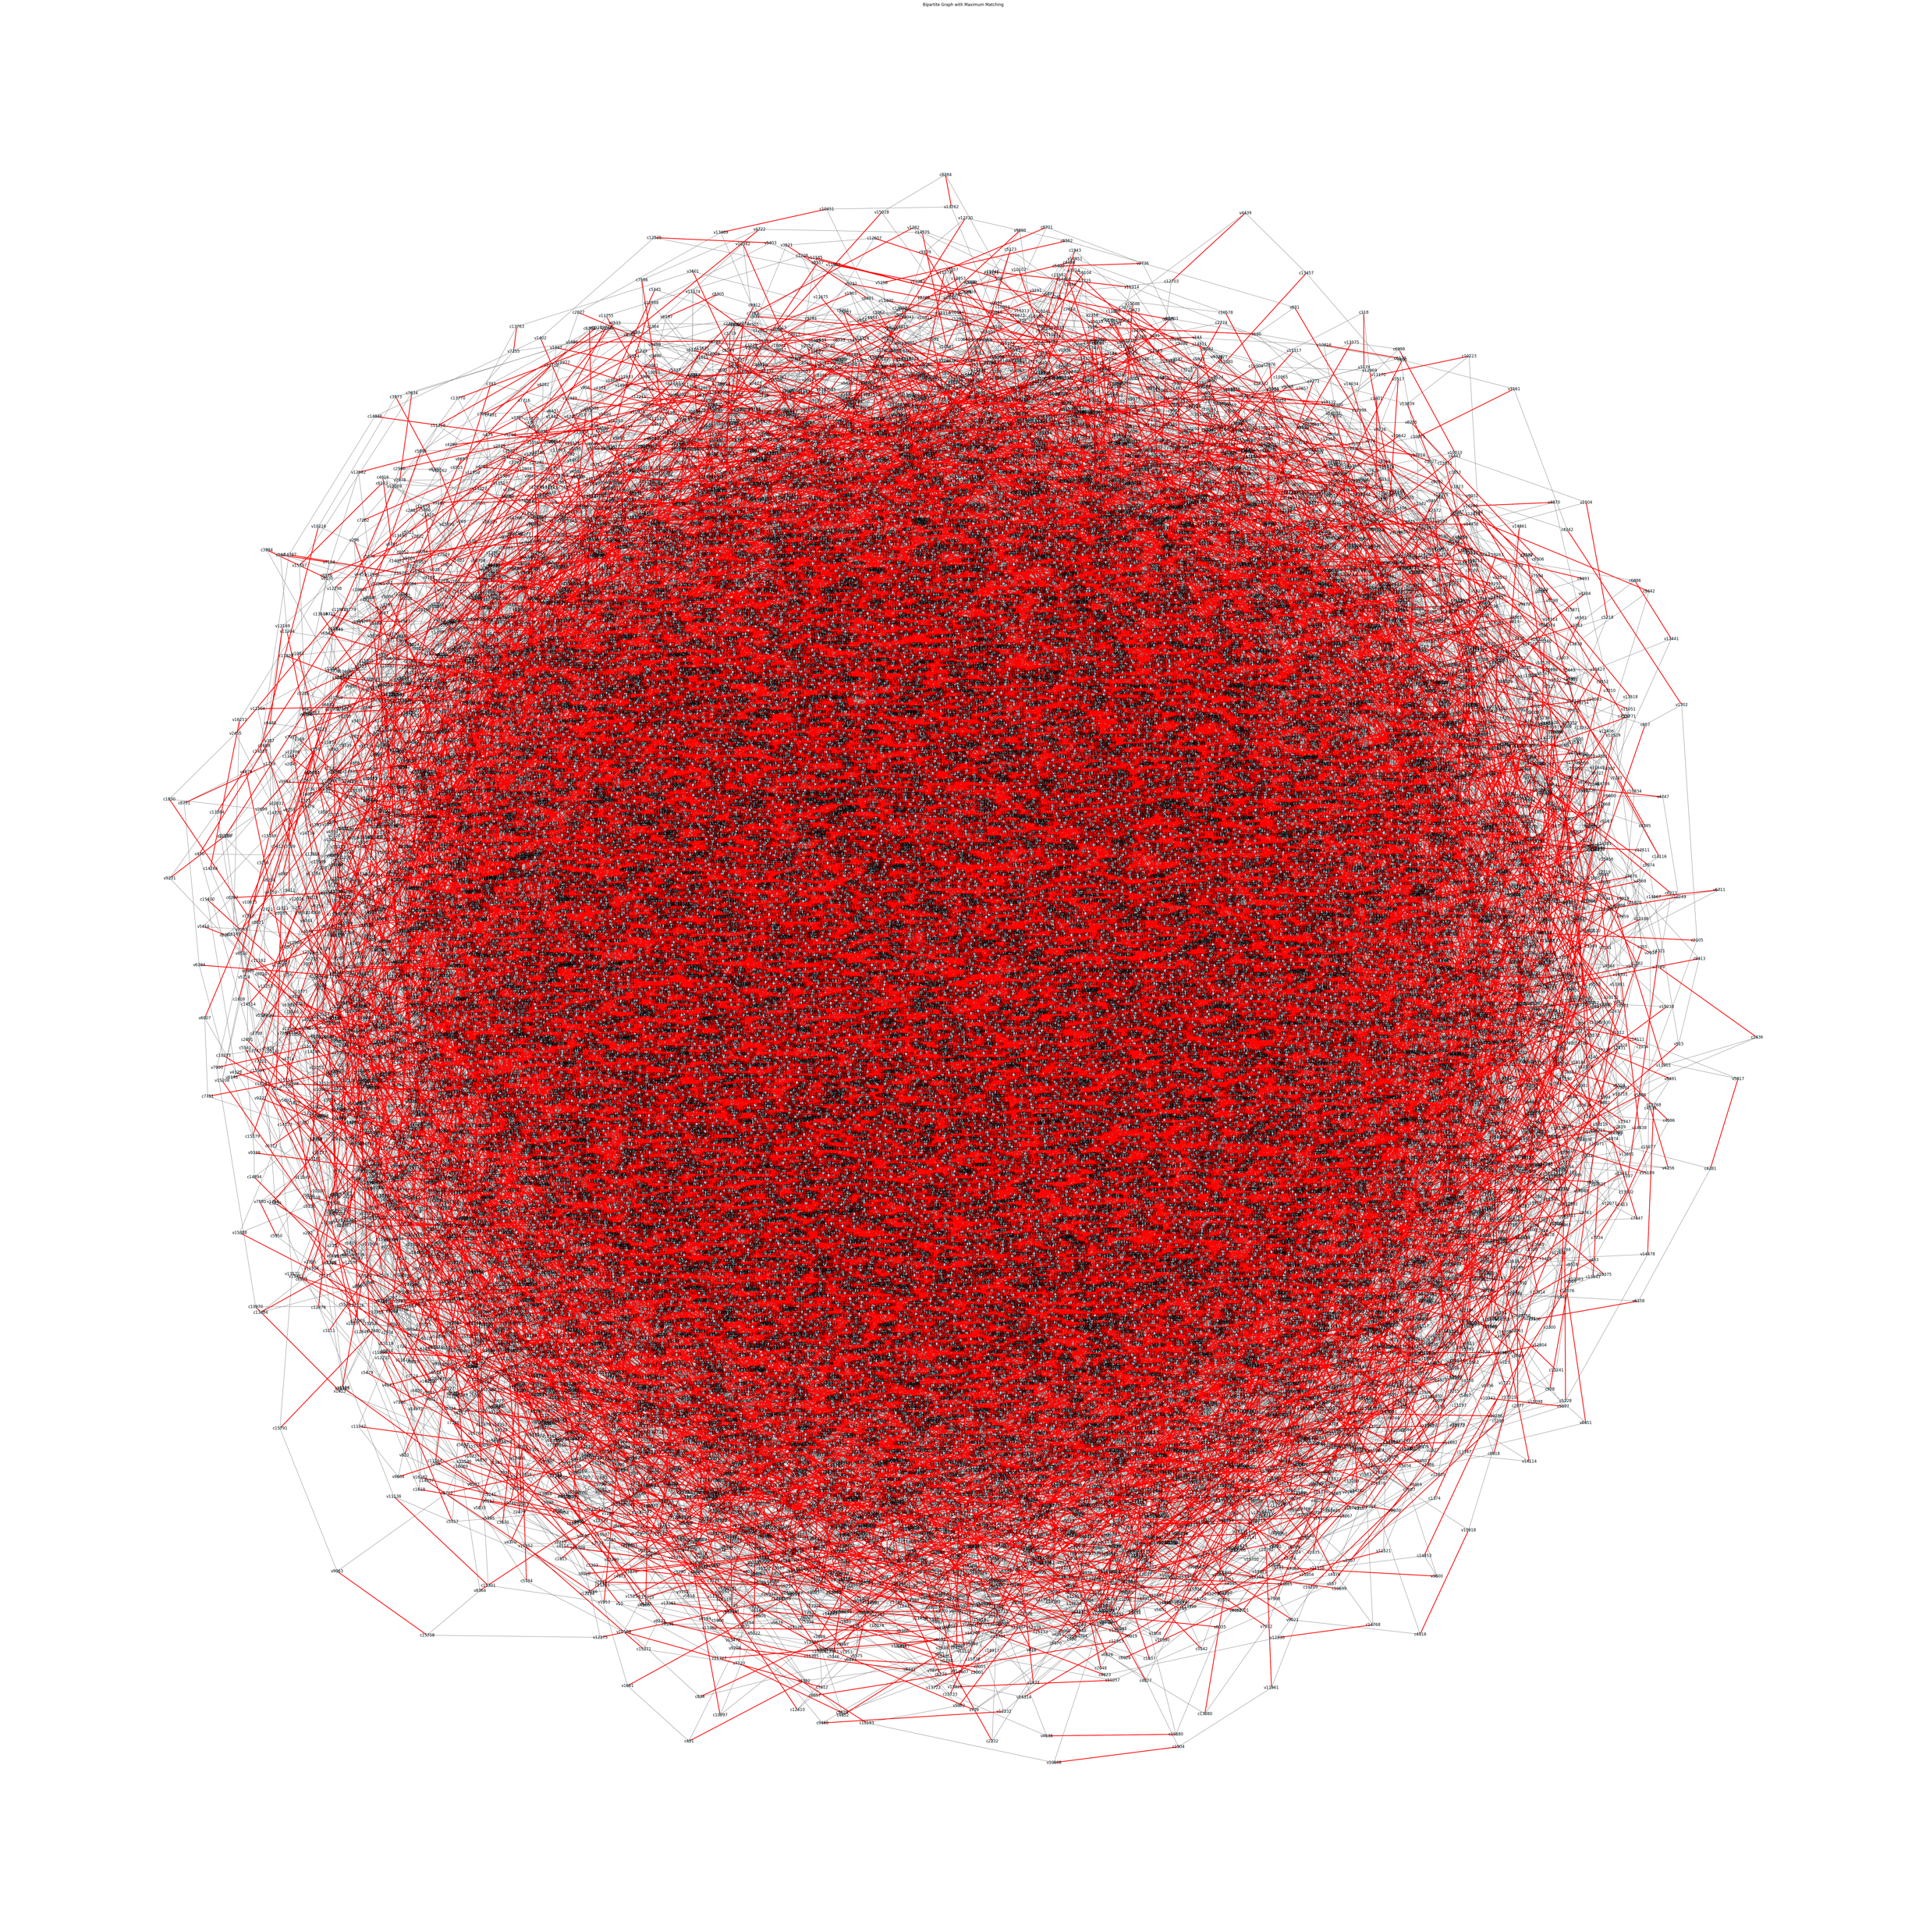

3SAT to Bipartite Matching
INPUT FORMAT
OUTPUT FORMAT

